Slide 1
Dual education system reforms in Andijan

Slide 2
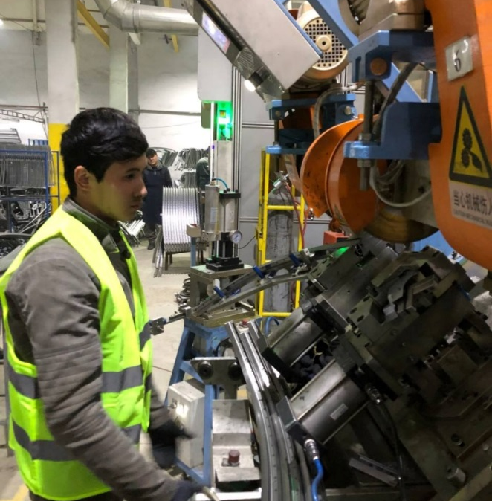
In order to organize internships at a number of enterprises and organizations in the Andijan region, as well as to study the quality of dual education and gain experience, a delegation from the Fergana region, consisting of directors of vocational schools, technical schools, and colleges, inspected internships at enterprises and organizations in Andijan.
Andijan's
experience

Slide 3
The implementation of the presidential order is in progress
Students are gaining practical skills and knowledge in dual education
A number of practical works are being carried out at the Andijan Institute of Mechanical Engineering to ensure the tasks set by the Head of State at the videoconference meeting on June 20, 2024 on the issues of training personnel in engineering fields and further improving the activities of higher educational institutions.

Slide 4
In particular, the institute has established permanent cooperation with the limited liability company "Avtokomponent" located in Asaka on the basis of the chain "Industry - Enterprise - University".
In the current academic year, branches of the institute's departments of Mechanical Engineering Technology, Equipment and Automation of Mechanical Engineering Production, and Technological Machines and Equipment were established in the company.
Accordingly, at the enterprise, students are practicing the theoretical knowledge they have received in classes in the production process. In addition, classes are held by experienced employees and specialists, developing the professional skills and abilities of students.

Slide 5
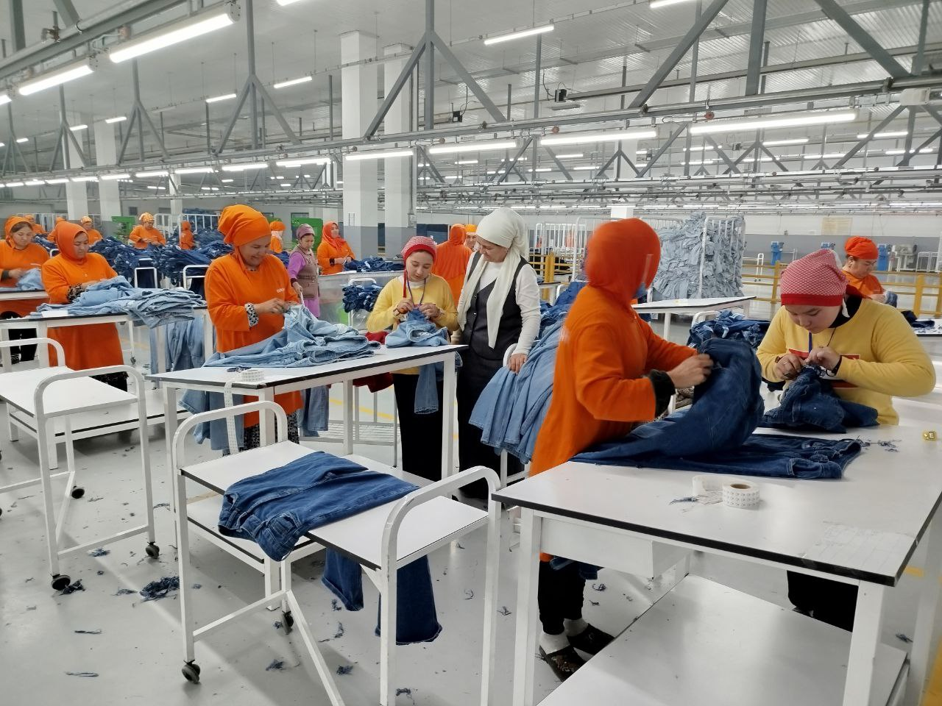
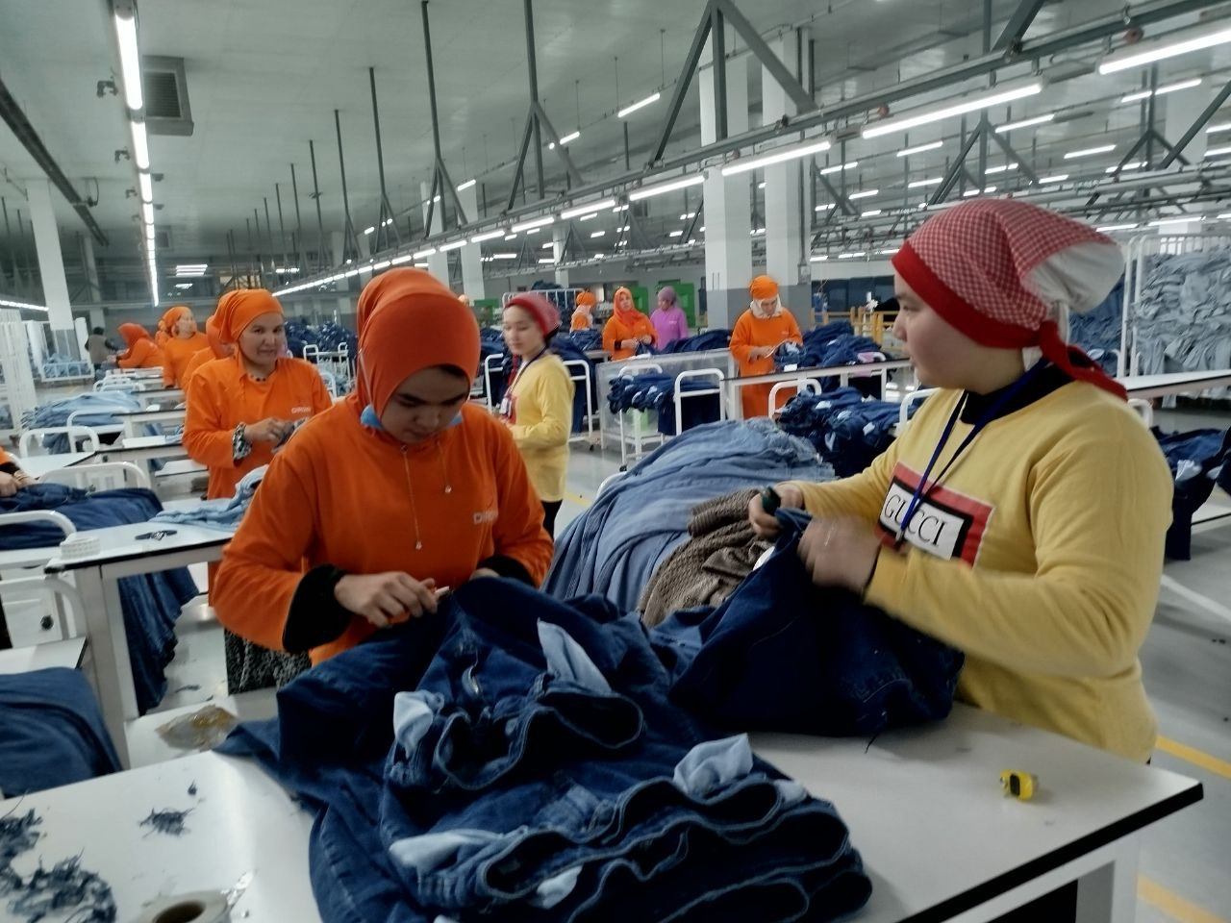
By order of the Andijan regional governor, vocational schools in Andijan city have been opened to cooperation programs and internships with "Dirom" LLC, located in Andijan city.

